Slide 1
ECE20016-01/ITP20003 Java Programming
Useful Development Tools: IDE, git/GitHub
JC

Slide 2
Tentative Schedule
Weeks | Topics
1 | Introduction Java Runtime environments
2 | Object-oriented concept Packages and objects
3 | Class and its members
4 | Language Basics, Branching and Loop
5 | String and Number classes
6 | Arrays, Recursion
7 | Inheritance, Polymorphism, and Interfaces Abstract data type and Interfaces
8 | Basic data structures ArrayList
9 | HashMap Midterm Exam
10 | Exception Handling, Streams and File I/O (1)
11 | Streams and File I/O (2), Java Programming practice (1)
12 | Java Programming practice (2), Dynamic Data structure and Generics (1)
13 | Dynamic Data structure and Generics (2) GUI and Event-driven Programming (1)
14 | GUI and Event-driven Programming (2), Concurrency (1)
15 | Concurrency (2) , Summary
16 | Final
* This schedule can be modified according to the students’ performance and other reasons.

Slide 3
Start Java projects
Code editors
...
IDE
IDE + git
IDE + git + build tool
IDE + git + build tool + GitHub

Slide 4
Agenda
Integrated Development Environment: Eclipse
Software repository
Git, GitHub

Slide 5
Integrated Development Environment (IDE)
https://en.wikipedia.org/wiki/Integrated_development_environment
Provide comprehensive facilities to computer programmers for software development
Source code editor
Build automation tool
Debugger
...

Slide 6
IDE for Java
Eclipse https://www.eclipse.org/
IntelliJ https://www.jetbrains.com/idea/
NetBeans https://netbeans.org/
Various editors with useful plugins
VSCode
Atom
vim
...
Eclipse vs. Intellij the Holy war...
https://www.upgrad.com/blog/intellij-idea-vs-eclipse-the-holy-war/#:~:text=Eclipse%20falls%20short%20in%20providing,help%20you%20improve%20your%20code.

Slide 7
Install Eclipse!
https://docs.google.com/presentation/d/1x-W6M9yJblBrLYJ9fvZHyR33lJVzpQAlc_MNZ_Zsb5c/edit#slide=id.g4fcd28a31e_0_50

Slide 8
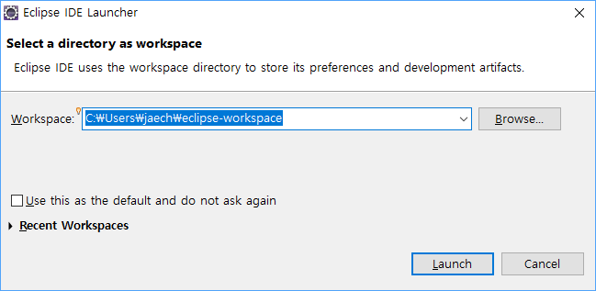
Workspace (작업공간)
Physical folder where your Eclipse projects are saved!

Slide 9
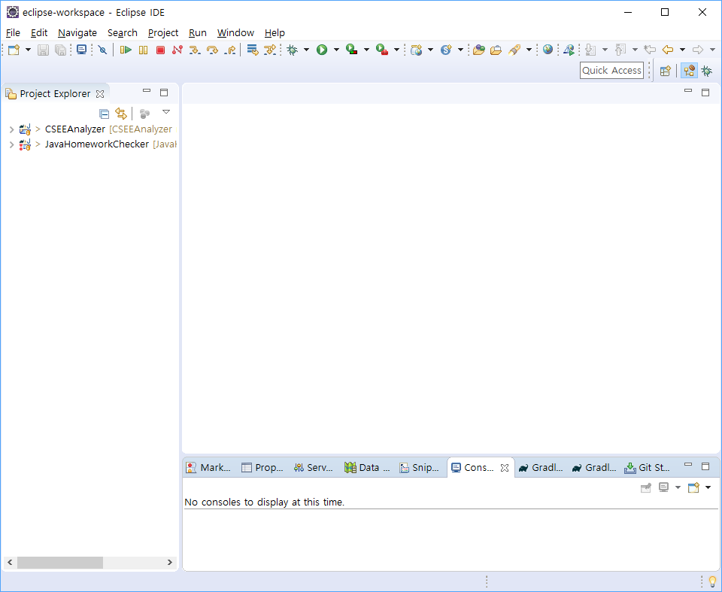
Workbench window!
Editors
Views

Slide 10
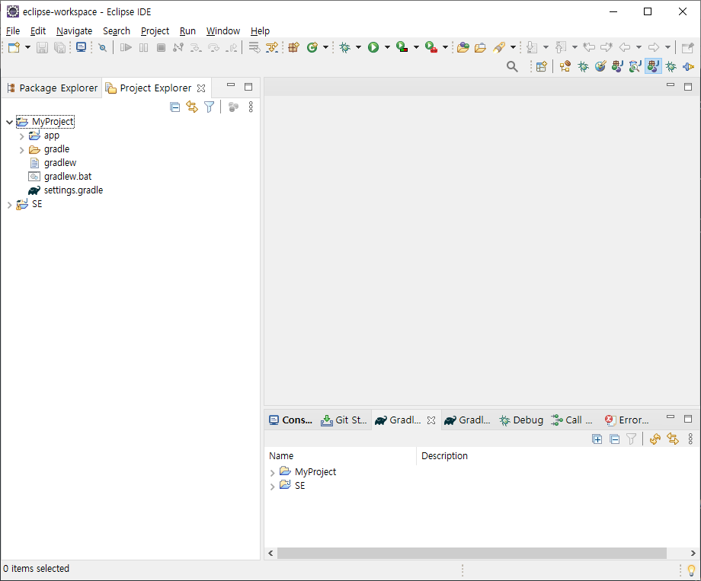
Perspective: Various workbench layout
← Java Perspective!
Change perspective
Window > Perspective > Open Perspective
Add Views
Window > Show View > Project Explorer
Move Views: Drag&Drop

Slide 11
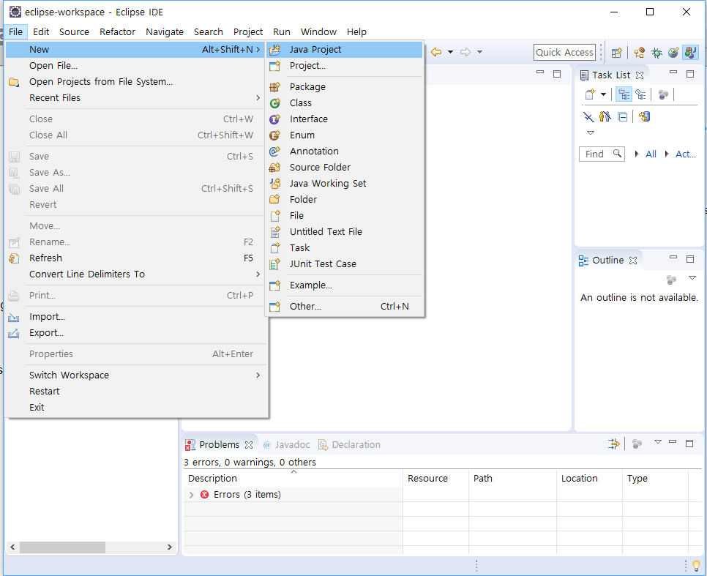
Add new Java Project!

Slide 12
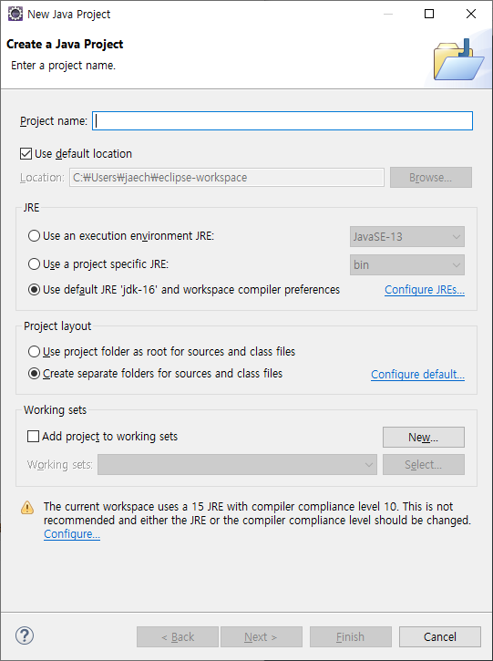
Add new project
Write a project name
Use default options but you may choose other options as well.
Choose Finish or Next
Finish: Create a Java project with default options
Next: You can change options.

Slide 13
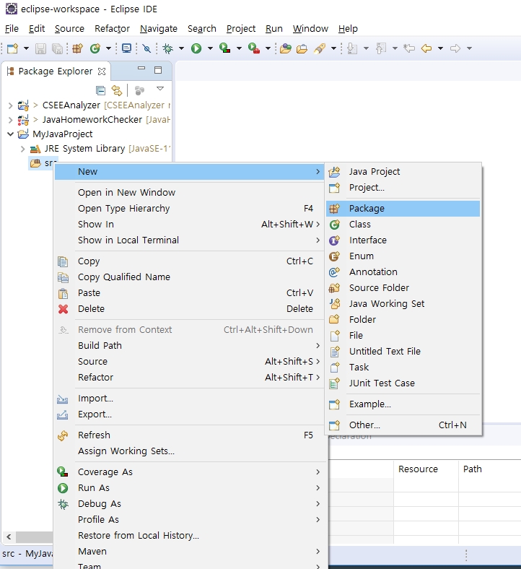
Add Package

Slide 14
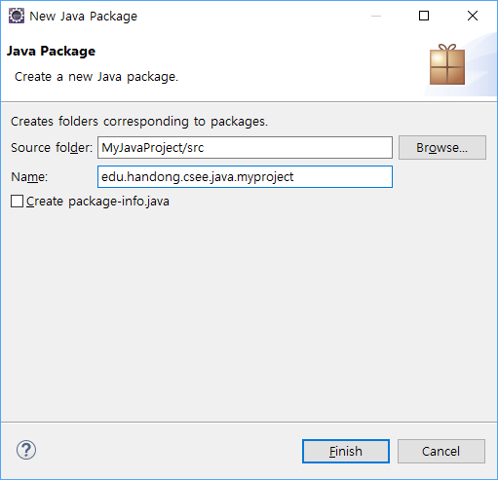
Add package
Put a package name in Name:
Click finish!

Slide 15
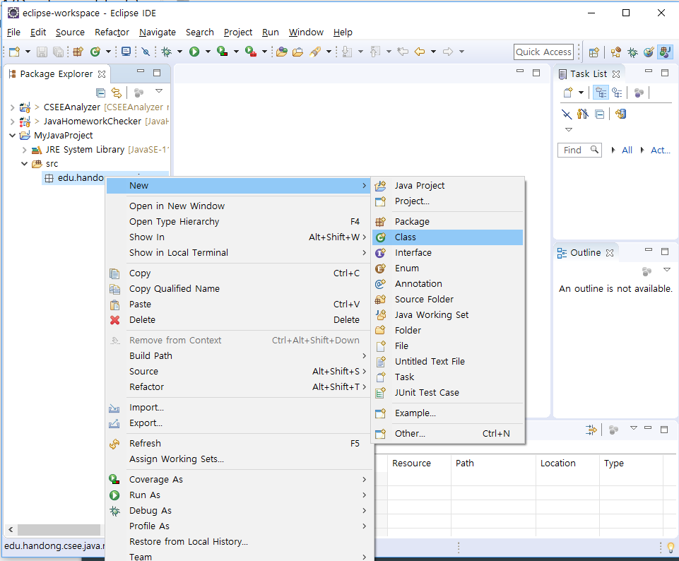
Add a .java file
Choose what you want to add under the given package!

Slide 16
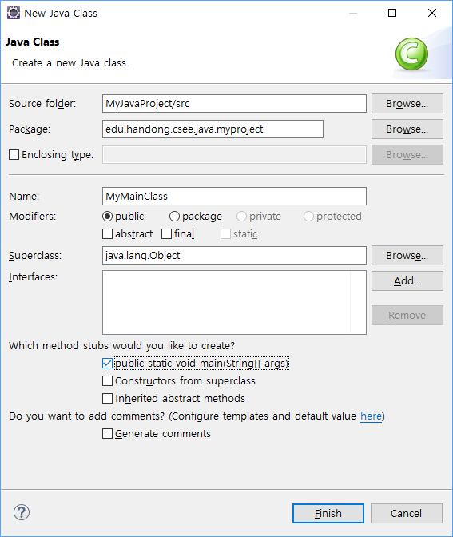
Add a .java file
Put a class name in Name:
If you want to add a main method, check the option "public static void main(String[] args)".
Use other options if needed!

Slide 17
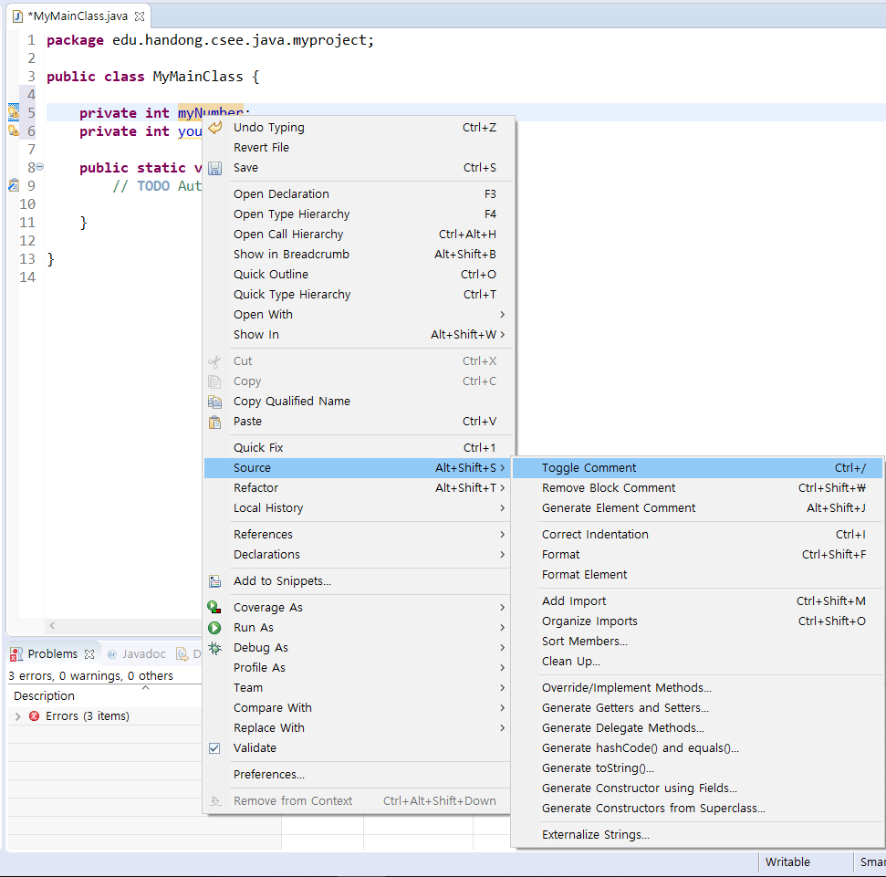
Coding in editors
Various source menu useful!!
Generate Getters and Setters
Correct Indentation
Format
Generate Block Comment
….

Slide 18
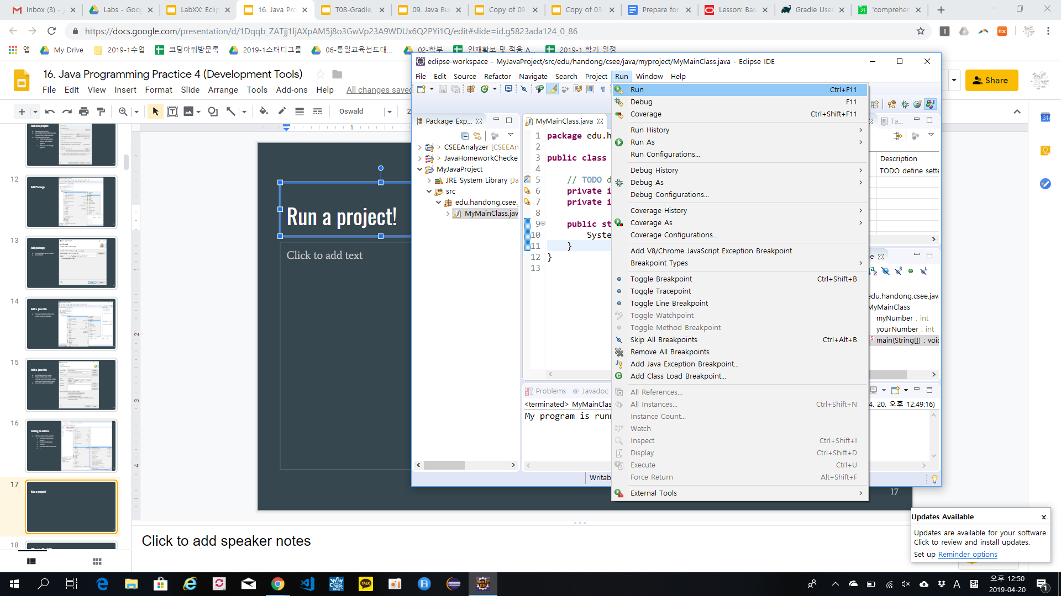
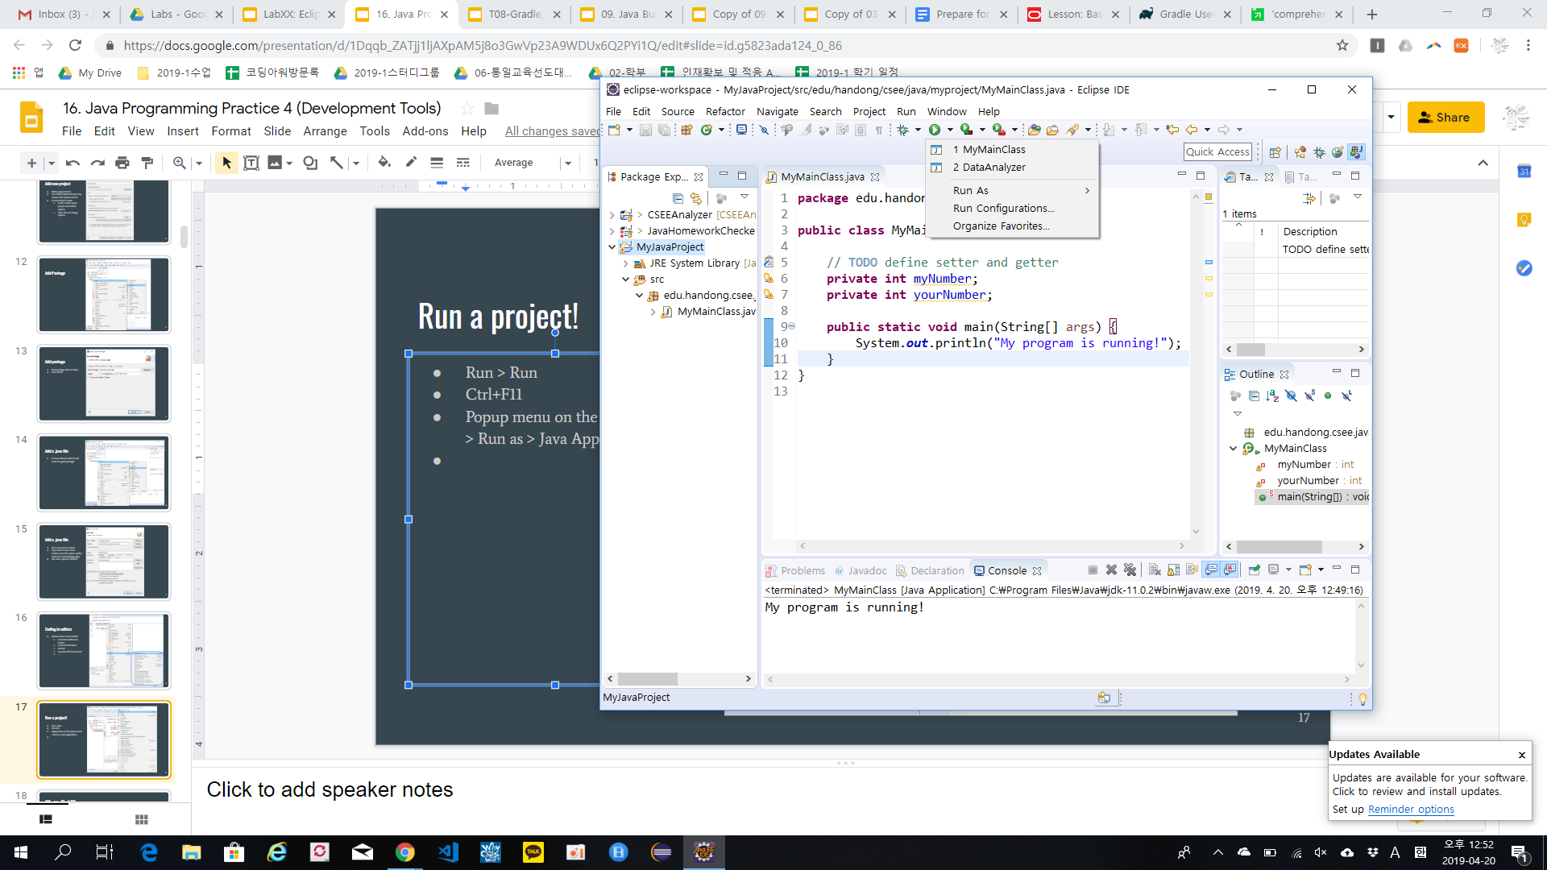
Run a project!
Run > Run
Ctrl+F11
Popup menu on the project name > Run as > Java Application
Use the green button!
Console view shows results!

Slide 19
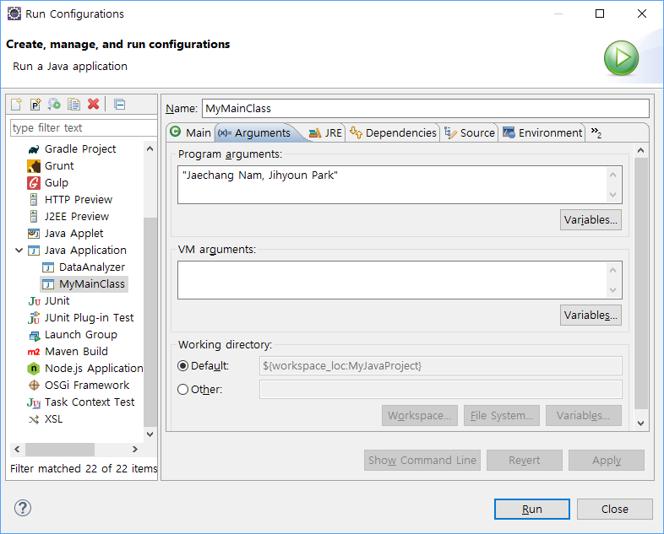
Run a project with CLI arguments!
Popup menu on a project name > Run as > Run Configurations!
Choose a class name where the main method exists.
Add CLI arguments in the 'Arguments' tab.
Click Apply or Run.

Slide 20
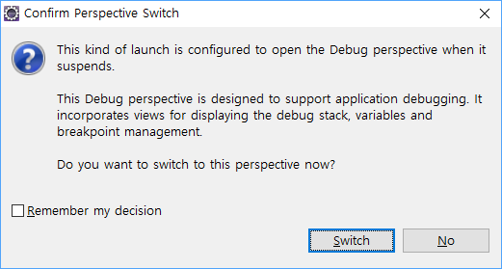
Use Debugger
Click a line number you want to break!!
Run a project with 'Debug As'
Popup menu on a project name > Debug as > Java Application
Or use a bug icon!
Then, you will be asked if you open the Debug perspective!
Click 'Switch' to open it!

Slide 21
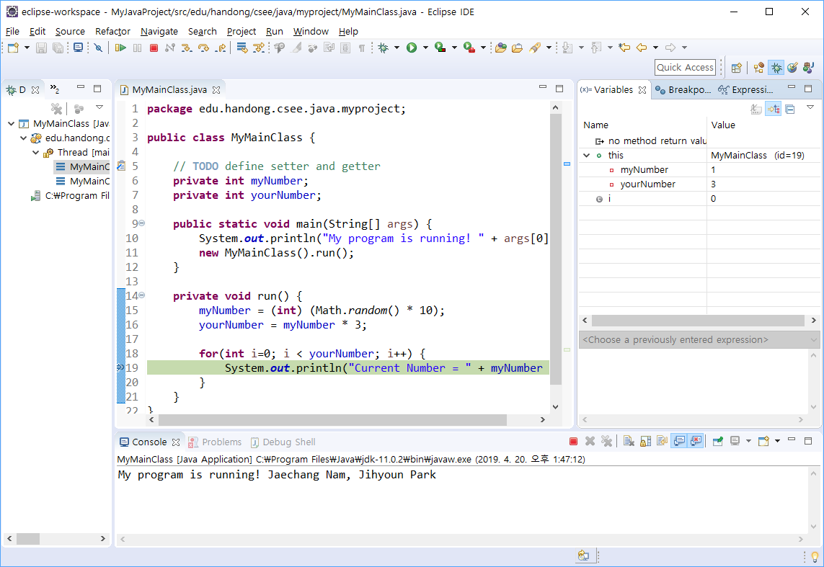
Use Debugger
You can check values of variables in the 'Variables' view when the program execution stops at the break point.

Slide 22
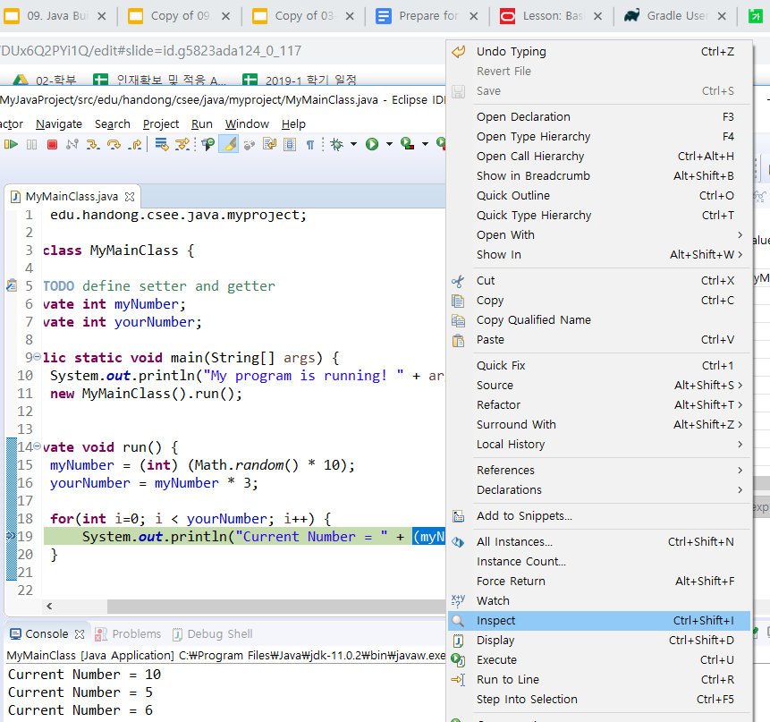
Use Debugger
Inspect an evaluation results for a selected expression whiling using Debugger.

Slide 23
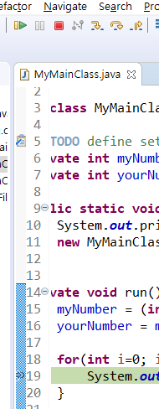
Use Debugger
Control execution!
Resume (F8)
Run until the next break point!
Terminate
Step Into ( F5)
Move into a method
Step Over (F6)
Next statement
Step return (F7)
Exit the current method.

Slide 24
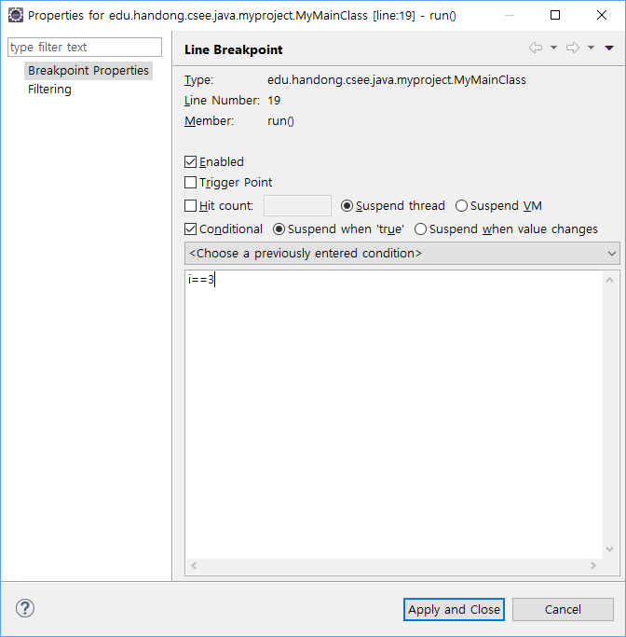
User Debugger
Set a breakpoint with conditions
Click the line number
Popup menu on the breakpoint > Breakpoint Properties…
Tick the ''Conditional' check box.
Write conditions for the breapoint

Slide 25
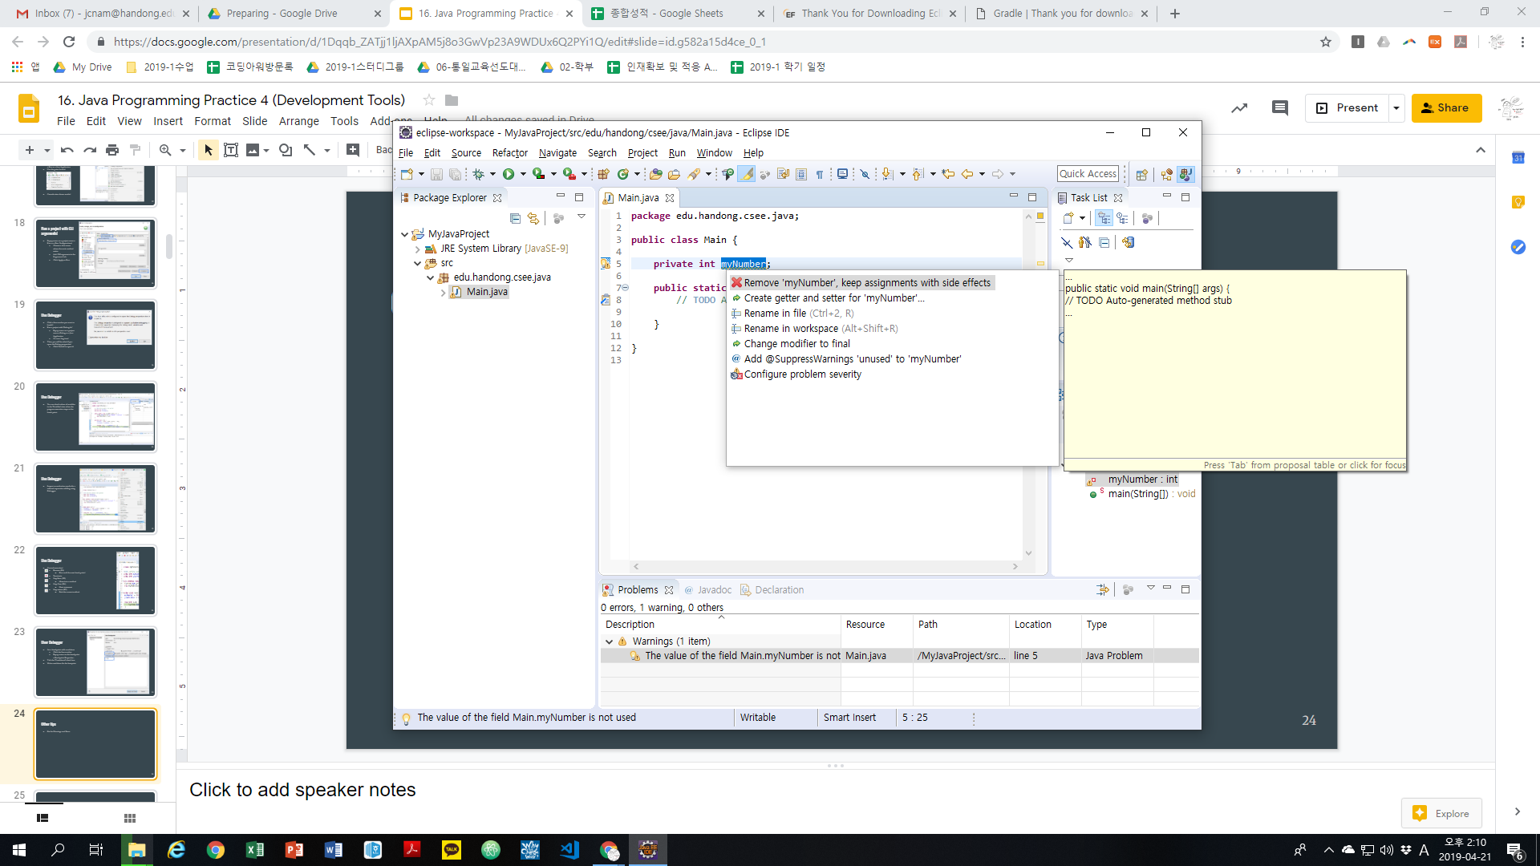
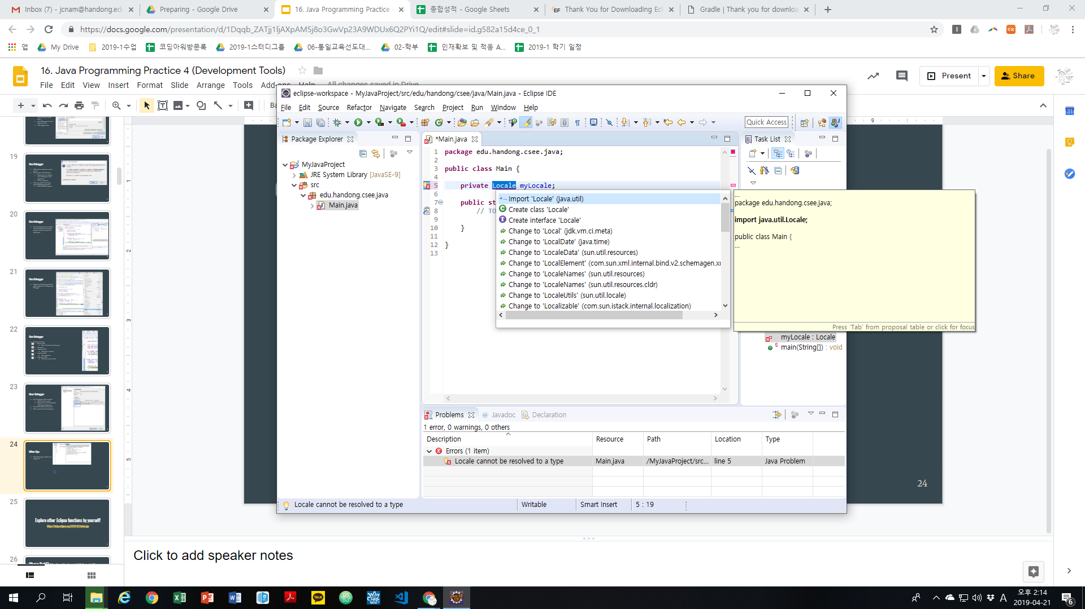
Other tips
Fix for Warnings and Errors by suggestions
Click Warning or Error sign beside each line number

Slide 26
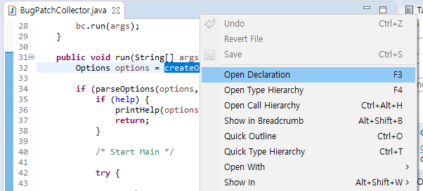
Other tips
Open Declaration (F3)
Open a source code file where you want to see declarations for variables, methods, classes, etc.
Open Call Hierarchy (F4)
Open a view that shows call hierarchy for a certain method.

Slide 27
Explore other Eclipse functions by yourself!
https://help.eclipse.org/latest/index.jsp

Slide 28
Agenda
Integrated Development Environment: Eclipse
Software repository
Git, GitHub

Slide 29
Software Repositories
Offline or online storages where all development artifacts are saved and maintained!
Version control systems: git, Mercury, Subversion, CVS
Issue tracking systems: Jira, BugZilla,...
Online software development platforms: GitHub, bitbucket, …
...
Development artifacts
Source code
Issue reports (bugs, new features, enhancement, suggestions, …)
...

Slide 30
Git
Distributed version control system
All source code changes are maintained.
You can see all change history!
Git can be used as offline systems or remote systems!
You can clone your git repository to a remote repository and vice versa.
When your git is connected with a remote git,
you can push your code to the remote git, and
you can pull your code from the remote git.
By doing this, developers can work for the same project remotely!
Install git: https://git-scm.com/ > Download and Install!

Slide 31
One of most powerful git feature: Branching!
You can manage your code in different branches on the same local folder in your PC!
By switching a branch, you can easily manage multiple code tasks!

Slide 32

A recommended git branching model
mater
Manage versions to release
develop
Main development branch
hotfix
bug patch
feature
add new features in your project
...

Slide 33
GitHub
Online software development platform based on git
Used as remote git repositories.
Support issue report systems.
Fork (copy) other projects into your GitHub account!
Support pull request!
If you can fix bugs or add new features for open-source projects, you can ask developers from the open-source projects to pull your code!
You can contributes to the open-source projects!!

Slide 34
Explorer by yourself
Git: https://git-scm.com/book/ko/v2
GitHub: Google search results about GitHub Tutorials

Slide 35
Start Java projects
Code editors
IDE
IDE + git
IDE + git + build tool
IDE + git + build tool + GitHub

Slide 36
Demonstrations
1. Create a new java project using all tools
https://docs.google.com/presentation/d/1Uqp3aLfk7ChW89-mlCSEjsbJyW5_hB3SYcXgOOYBQNA/edit#slide=id.p
2. Import the existing project created by all tools from a GitHub https://docs.google.com/presentation/d/1CT56TgE2lXM9Qg6mUulSU1USnU_gTO56C2fl5a4FUi4/edit#slide=id.p
https://github.com/lifove/CLAMI
3. Commit, push, and pull in Eclipse https://docs.google.com/presentation/d/1CT56TgE2lXM9Qg6mUulSU1USnU_gTO56C2fl5a4FUi4/edit#slide=id.p

Slide 37
Tentative Schedule
Weeks | Topics
1 | Introduction Java Runtime environments
2 | Object-oriented concept Packages and objects
3 | Class and its members
4 | Language Basics, Branching and Loop
5 | String and Number classes
6 | Arrays, Recursion
7 | Inheritance, Polymorphism, and Interfaces Abstract data type and Interfaces
8 | Basic data structures ArrayList
9 | HashMap Midterm Exam
10 | Exception Handling, Streams and File I/O (1)
11 | Streams and File I/O (2), Java Programming practice (1)
12 | Java Programming practice (2), Dynamic Data structure and Generics (1)
13 | Dynamic Data structure and Generics (2) GUI and Event-driven Programming (1)
14 | GUI and Event-driven Programming (2), Concurrency (1)
15 | Concurrency (2) , Summary
16 | Final
* This schedule can be modified according to the students’ performance and other reasons.

Slide 38

TODOs
Read all topics here: https://docs.oracle.com/javase/tutorial/java/concepts/index.html Read Ch9.3 (p.348~353)
JC Nam, jcnam@handong.edu, https://lifove.github.io

Slide 40
Lab08: Development tools for Java: Build tool, IDE, and Software repository
L17
https://docs.oracle.com/javase/tutorial/java/IandI/index.html
Textbook: Ch 11. Inheritance and Polymorphism Ch 13. Abstract Classes and Interfaces
JC Nam, jcnam@handong.edu, https://lifove.github.io

Slide 41
L17: Development tools for Java: Build tool, IDE, and Software repository
https://docs.oracle.com/javase/tutorial/java/IandI/index.html
Textbook: Ch 11. Inheritance and Polymorphism Ch 13. Abstract Classes and Interfaces
JC Nam, jcnam@handong.edu, https://lifove.github.io

